Slide 1
Hill Cipher
Implemented using Haskell

Slide 2
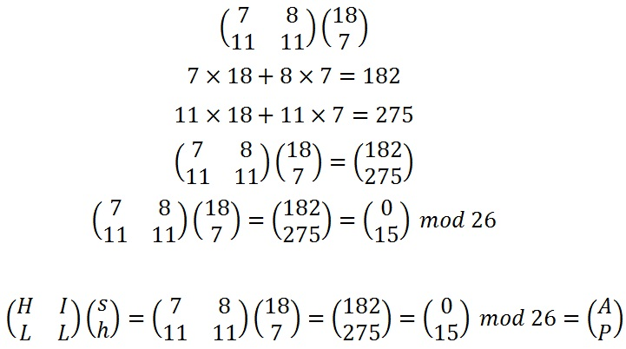
What is Hill Cipher?
In short, Matrix Multiplication!
Encoding ‘sh’ with Hill Cipher

Slide 3
What is Hill Cipher?
In short, Matrix Multiplication!
Encoding ‘sh’ with Hill Cipher

Slide 4

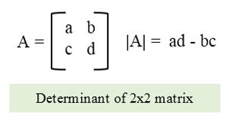
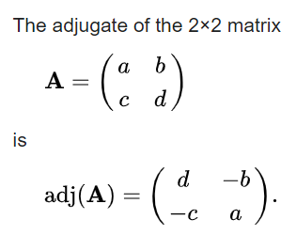
Key Generation
Rules (ambiguous, i.e., one-way encryption, or uncalculatable if conditions not met):
The GCD of the determinate of the key and the modulo (in our case 26) must be 1
Must be square (n x n) in size (otherwise the matrix is not invertible)
Encryption Key:
In general, can be letters converted to numbers or plain numbers. Ours uses 2x2 with letters.
Decryption Key:
Must be calculated such that: d*d⁻¹ ≡ 1 mod 26 (look familiar?) where d = the determinate and d⁻¹ is the multiplicative inverse (inverse gcd) of the determinate and the modulo
Find the adjugate matrix of the key
In proper terms, given matrix M, determinant D, and adjugate Adj then the decryption key is found by the following equation:
M⁻¹ = D⁻¹ x Adj (where M⁻¹ is the decryption key)
The most basic determinant
The most basic adjugate

Slide 5
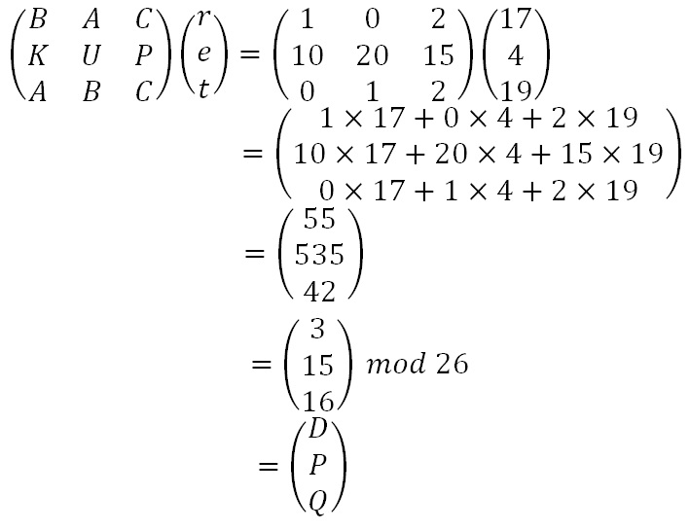
Encryption/Decryption Method
Perform matrix multiplication on each block of your message!
Blocks of text defined by the size of the matrix for example, 2x2 is parsed into chunks (sometimes referred to as ‘vectors’) of 2s, 3x3 the message is parsed into 3s (shown at left), et cetera
Used for both encryption and decryption
Only difference is the keys used (and, if used properly, the message)
Given part ‘ret’ of ‘retreat nowxx’ and the key ‘BAC/KUP/ABC’

Slide 6

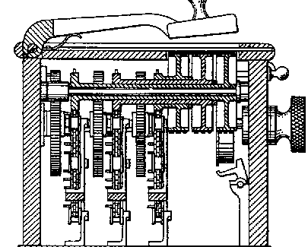
Brief Historical Note
Originally invented by Lester S. Hill and implemented as a single machine with gears (pictured)
Original recommendations for use included not only the Hill Cipher method we know today, but recommendation for using it 3 times as well as a ‘secret step’ involving another cryptographic method as Hill felt this was too easily cracked alone
His machine did not sell, in large part due to the limitation of the keyset, and that each machine only shipped with a very limited set of unique keys
Our implementation (like most modern uses) attempt to mitigate the limited keyset issue by using input restrictions rather than a rigid keyset
Hill’s Original Machine

Slide 7
Advantages and Disadvantages of Hill
Advantages:
Good masking of original message
Useful as an intermediary step in other ciphers, like AES, due to diffusion
Disadvantages:
Is completely linear
Restrictions on the Key matrix, coupled with size of key, produce finite possible keys
Becomes incredibly laborious to do by hand with longer keys/messages
Recommendations:
Like the original creator, this probably should be used as a piece of a larger system rather than stand alone, such as feeding multiple times or/and adding another method like Playfair, Railfence, Vernam, Vigenère, et cetera but its standalone nature allows the steps to be switch out, much like keys themselves
Notes:
Confusion = mask relationship between ciphertext and Key
Diffusion = mask relationship between ciphertext and plaintext

Slide 8
Our Implementation
Key and message are input by the user
The key must be 4 characters long, in order to fit a 2x2 matrix
Encryption text is padded with ‘x’ to ensure the number of characters is divisible by 2, and to separate duplicate letters
For example, ‘hello’ becomes ‘helxleox’
Decryption checks the message to ensure it is divisible by 2, but does not pad
For example, errors on ‘%^’ (result is empty string due to filter) and ‘DVT’ (not divisible by 2)

Slide 9
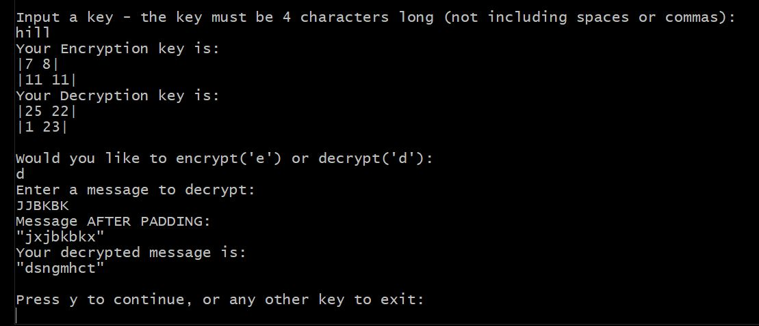
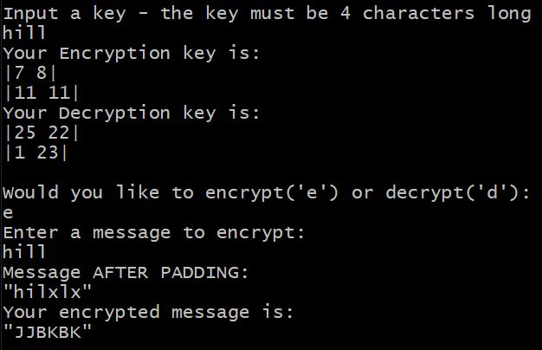
Program Example
Example of Decryption if it used padding

Slide 10
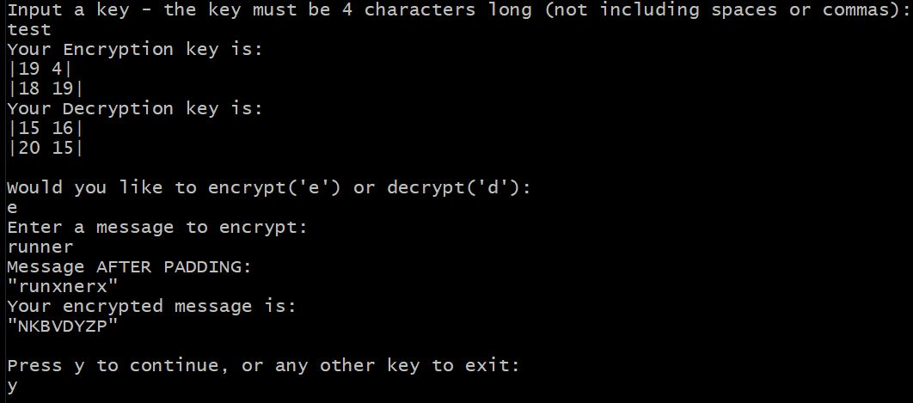
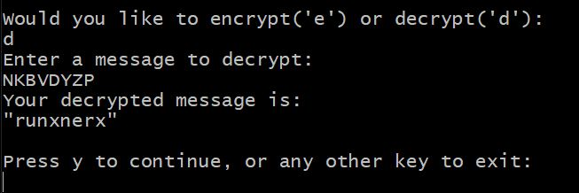
Program Examples Continued
Example of successful run using message ‘runner’ and key ‘test’

Slide 11
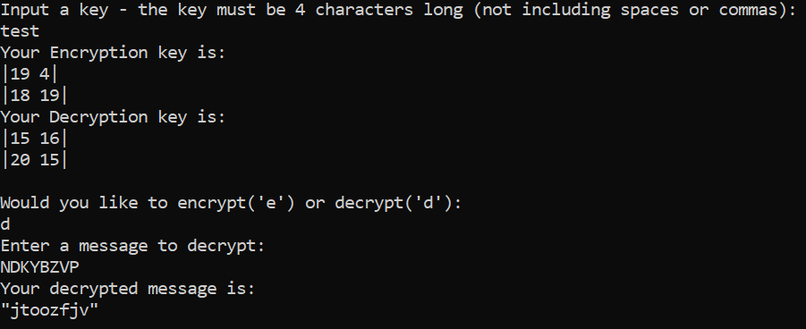

Program Examples Continued
Example of Using a Railfence (2 rails) Cipher for Further Security

Slide 12
Works Cited
Image Hill cipher. (n.d.). Retrieved February 26, 2021, from https://crypto.interactive-maths.com/hill-cipher.html
Image: C program to find determinant of a matrix. (n.d.). Retrieved February 26, 2021, from https://www.cprogramcoding.com/p/box-sizing-border-box_474.html
Before Encrypting, Encryption, and Decryption instructions: Hill cipher. (2021, January 30). Retrieved February 26, 2021, from https://en.wikipedia.org/wiki/Hill_cipher
Image and Hill’s original Recommendations: Hill cipher Wikipedia. Retrieved March 9, 201 from https://en.wikipedia.org/wiki/Hill_cipher
Original Patent also Referenced (retrieved from Google Patent’s on March 9, 2021): 1499078770744343042-01845947 (storage.googleapis.com)
Image Hill cipher. (n.d.). Retrieved February 26, 2021, from https://crypto.interactive-maths.com/hill-cipher.html
Image Adjugate Matrix: Adjugate matrix. (2021, February 25). Retrieved February 26, 2021, from https://en.wikipedia.org/wiki/Adjugate_matrix
Image Hill cipher. (n.d.). Retrieved February 26, 2021, from https://crypto.interactive-maths.com/hill-cipher.html
Limited Key Issues: A Short History of Cryptography Ch. 2.1 (1990, 1995 Cohen, F.) retrieved March 9, 2021 from 2.1 - A Short History of Cryptography (all.net)

